Slide 1
Present like Steve Jobs
Adapted from Carmine Gallo
The Presentation Secrets of Steve Jobs (2010)

Slide 2
Theme Passion Structure
https://www.youtube.com/watch?v=mlebroNM_ww
Carmine Gallo: The Presentation Secrets of Steve Jobs 3:09mins
Notes:
Published on Feb 3, 2015
A communications coach shares the techniques that make Steve Jobs a great speaker.
Anyone who has watched a Steve Jobs' keynote...
...will tell you he is one of the most extraordinary speakers in corporate America.
Who does the best job of that in the world?
While most presenters simply convey information, Jobs inspires.
I'm Carmine Gallo and today I'll walk you through several key techniques...
...that Steve Jobs uses to electrify his audience.
There are elements you can adopt in your very next presentation.
Welcome to Macworld 2008.
We've got some great stuff for you.
There's clearly something in the air today.
With those words Jobs opened Macworld 2008...
...setting the theme for his presentation and hinting at the major announcement of the day:...
...the launch of the ultrathin MacBook Air.
Whether it's a new notebook or the iPhone,...
...Jobs unveils a single headline that sets the theme.
Today, Apple is going to reinvent the phone.
Once you identify a theme, make sure it's clear and consistent throughout the presentation.
Think of a staff meeting as a presentation.
So let's say you're a sales manager...
...introducing a new software tool to help your team generate, track and share sales leads.
You might kick off your meeting this way, "Good morning, thanks for coming."
"I know you'll be really excited about this."
"Today, we make it easier for you to make your quota."
That's the headline, "Easier to Make Quota."
It's memorable and it sets the direction for the rest of your meeting.
It gives your audience a reason to listen.
I've got four things I'd like to talk about with you today.
So let's get started.
Steve Jobs always provides an outline for his presentation,...
...and then verbally opens and closes each section with a clear transition in between.
Here's an example.
So that's Time Capsule, a perfect companion to Leopard,...
...and that's the first thing I wanted to share with you this morning.
The point is, make it easy for your listeners to follow your story.
Your outline will serve as guideposts along the way.
You'll also notice that during his presentations...
...Jobs uses words like extraordinary, amazing and cool.
He is passionate and enthusiastic, and it shows.
Incredible. Unbelievable. Amazing. Awesome. Extraordinary year for Apple.
You know your audience wants to be wowed, not put to sleep.
Too many people fall into this "presentation mode."
It's stiff, it's formal, it lacks pizzazz.
We, your listeners, are giving you permission to have fun and to be excited...
...about your company, your product or your service.
If you're not passionate about it, we're not going to be.

Slide 3
1. Set a headline for presentation
“Today Apple reinvents the phone!”
“The world’s thinnest notebook”
“1000 songs in your pocket!”

Slide 4
2. Express your Passion
“I am excited about ____________ (product, service, initiative, idea) because it ________________.”

Slide 5
3. Structure your story: Rule of Three in iPhone
1. Widescreen ipod with touch controls
2. Revolutionary mobile phone
3. Breakthrough Internet communication device

Slide 6
Classic Rule of 3 in iPhone
https://www.youtube.com/watch?v=vZYlhShD2oQ
Carmine Gallo: The Presentation Secrets of Steve Jobs 3:09mins
Notes:
Published on Feb 3, 2015
A communications coach shares the techniques that make Steve Jobs a great speaker.
Anyone who has watched a Steve Jobs' keynote...
...will tell you he is one of the most extraordinary speakers in corporate America.
Who does the best job of that in the world?
While most presenters simply convey information, Jobs inspires.
I'm Carmine Gallo and today I'll walk you through several key techniques...
...that Steve Jobs uses to electrify his audience.
There are elements you can adopt in your very next presentation.
Welcome to Macworld 2008.
We've got some great stuff for you.
There's clearly something in the air today.
With those words Jobs opened Macworld 2008...
...setting the theme for his presentation and hinting at the major announcement of the day:...
...the launch of the ultrathin MacBook Air.
Whether it's a new notebook or the iPhone,...
...Jobs unveils a single headline that sets the theme.
Today, Apple is going to reinvent the phone.
Once you identify a theme, make sure it's clear and consistent throughout the presentation.
Think of a staff meeting as a presentation.
So let's say you're a sales manager...
...introducing a new software tool to help your team generate, track and share sales leads.
You might kick off your meeting this way, "Good morning, thanks for coming."
"I know you'll be really excited about this."
"Today, we make it easier for you to make your quota."
That's the headline, "Easier to Make Quota."
It's memorable and it sets the direction for the rest of your meeting.
It gives your audience a reason to listen.
I've got four things I'd like to talk about with you today.
So let's get started.
Steve Jobs always provides an outline for his presentation,...
...and then verbally opens and closes each section with a clear transition in between.
Here's an example.
So that's Time Capsule, a perfect companion to Leopard,...
...and that's the first thing I wanted to share with you this morning.
The point is, make it easy for your listeners to follow your story.
Your outline will serve as guideposts along the way.
You'll also notice that during his presentations...
...Jobs uses words like extraordinary, amazing and cool.
He is passionate and enthusiastic, and it shows.
Incredible. Unbelievable. Amazing. Awesome. Extraordinary year for Apple.
You know your audience wants to be wowed, not put to sleep.
Too many people fall into this "presentation mode."
It's stiff, it's formal, it lacks pizzazz.
We, your listeners, are giving you permission to have fun and to be excited...
...about your company, your product or your service.
If you're not passionate about it, we're not going to be.

Slide 7
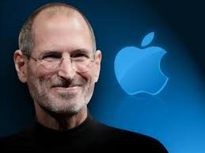
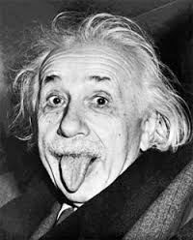
4. Visualize idea as metaphor/analogy
https://www.youtube.com/watch?v=Pdnw9H87k4A

Slide 8
Job’s metaphor for Teamwork
https://www.youtube.com/watch?v=Pdnw9H87k4A

Slide 9
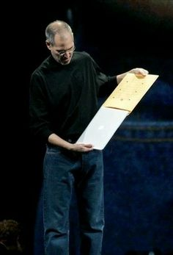
5. Use Demonstrations
MacBook Air 2008

Slide 10
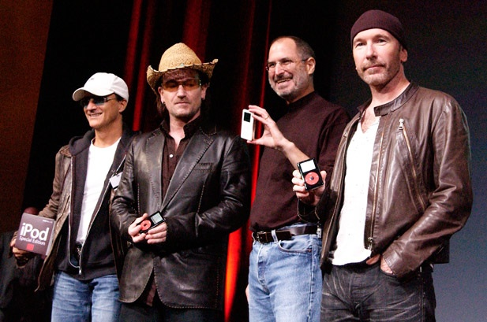
6. Use Partners & 3rd Party Endorsements
Jobs laughs with Jimmy Iovine, from left, Bono and The Edge of U2 at a celebration of the release of new iPod products in October 2004 in San Jose, California.

Slide 11
7. Use Video Clips
https://www.youtube.com/watch?v=mcD2FxNO49k
Job’s favourite iphone 3G ad: 0:30secs

Slide 12
8. Props & Show-and-Tell
https://www.youtube.com/watch?v=iAKzfzoSw5c
MacBook Pro Unibody Enclosure Show-and-tell at 2:55mins

Slide 13
10 Product Introductions—Steve Jobs
https://www.youtube.com/watch?v=dkDMvYCvqyA

Slide 14
iphone keynote 2007
https://www.youtube.com/watch?v=t4OEsI0Sc_s

Slide 15
MacBook Air Keynote 2008
https://www.youtube.com/watch?v=1CgAKBf4bbU

Slide 16
Ipad keynote 2010
https://www.youtube.com/watch?v=_KN-5zmvjAo

